Slide 1
What is Artificial Intelligence?
🐦 - @blit12_

Slide 2
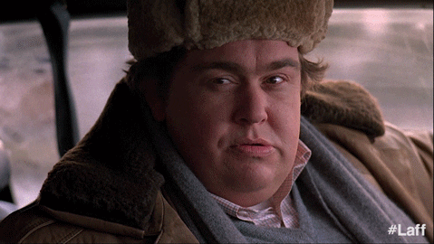
Am I intelligent?

Slide 3
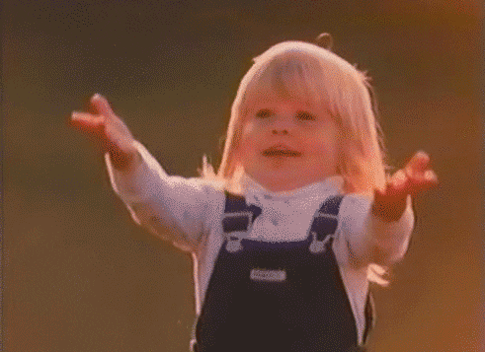


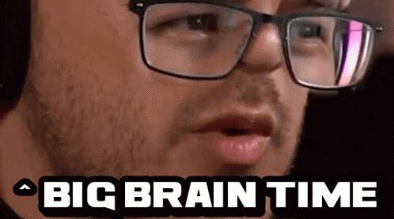
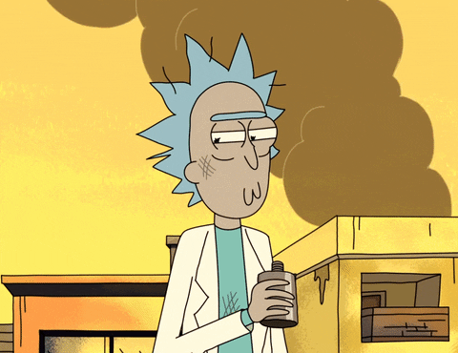
What is AI?
Notes:
Artificial intelligence is a bunch of:
Non-sense
Math
Try-catch-try
Alcohol
Big brain time

Slide 4
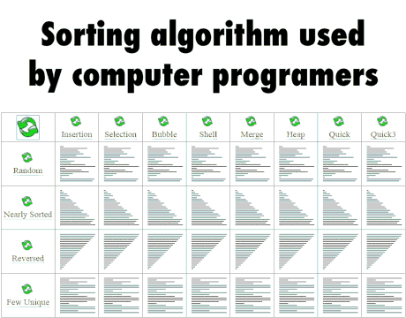
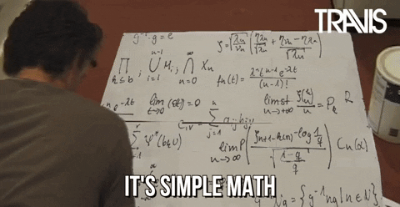
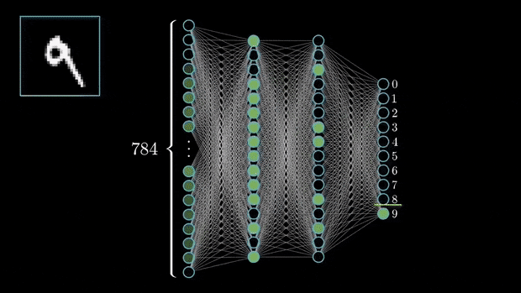
Now… seriously
Notes:
Math
Algorithms
Neural Networks → models

Slide 5
There are 3 fields
Artifical Intelligence (IA)
Algorithmic style
Space search focus
Examples:
Depth-search
Branch-search
Machine Learning (ML)
Mathematic Based
Classification focus
Examples:
Random Forest
Linear Regression
Deep Learning (DL)
Next level of insanity
Generation of non-cats
Examples:
Convolutional NN
GANs
PD: Goodfellow is god.
Notes:
Deep Learning: Generation of things in general, recognition of patterns, creation of patterns, etc.

Slide 6
So… What are we focusing on?
What are CNN? Not ML?
Pixels? Pizzels? Preztel? Pizza? IDK
Deep Learning!! Yeah!!
Convolutional Neural Networks!!
…
Notes:
Convolutional Neural Networks is a type of Neural Network that focuses on recognizing patterns/characteristics and learn them. This way, you can throw them a cat image and recognize where the cat is or if it is a cat! So, why is this not a Machine Learning problem? Well.. images are no “categorical” nor “quantitative” data, yeah Images have bytes which are numbers, but they alone do not represent nothing. And is not that simple to “understand” an image… I mean… Can you say what is the relation between pixels? I can’t jajsjsjajsja

Slide 7
What does this has to do with Self-driving cars?
Object detection
Decision Making
Behaviour planning
Notes:
Well, it has to do a lot… When you drive, or even walk, you are interpreting the data that is being collected from sensors. That is why when you walk and hit a lamppost, you learn nothing and just be mad at it. Imagine the same but for cars, instead of lamppost, persons… AND THERE THEY ARE!!! The f* simulators like CARLA or WEBOTS (in spanish is funny if you forgot the “T”). This kind of reality environment created are widely used in robotics, because you just need computers that can run your thing, instead of a whole robot/car that is going to be smashed because a “;” was left and the car didn’t had the breaks JAJSJAJJ
Now, back to the topic, the best way to test a bunch of models and kind of train them, is to use these simulators. Normally, you don’t train the NN on the simulator, because that would be a waste of time and resources, but you do use them to test how well it went, and if the dataset for the training was good enough to learn the key things to detect. There are more than one NN in self-driving cars. A car can have NN in:
Behaviour planning
Object detection
Decision making

Slide 8
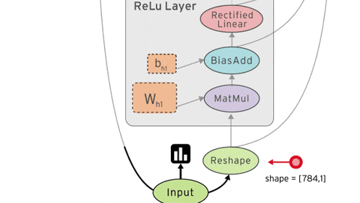
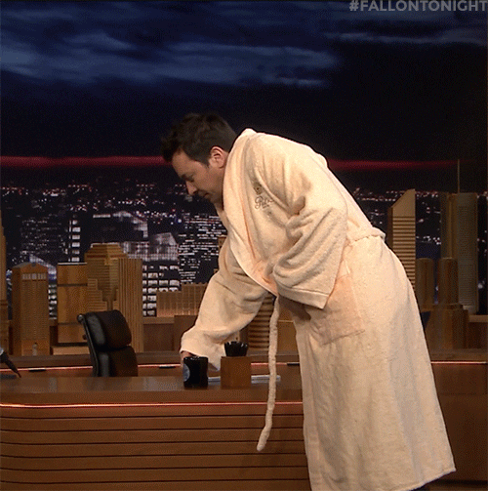


How can we create a model?
Notes:
These days we can create our own models or based on other ones that are better, using frameworks like “Tensorflow” or “Pytorch”. We “don’t even need math”, since it is all under the hood. But, if I am sincere with you, you DO need some math knowledge, at least to know what you are getting into XD
Now.. take a deep breath… let's get into how we can go from Images to recognizing what they are.

Slide 9
Steps
Gather Data
Process Data
Design Model
Create Model
Train Model
Test Model
Use Model

Slide 10
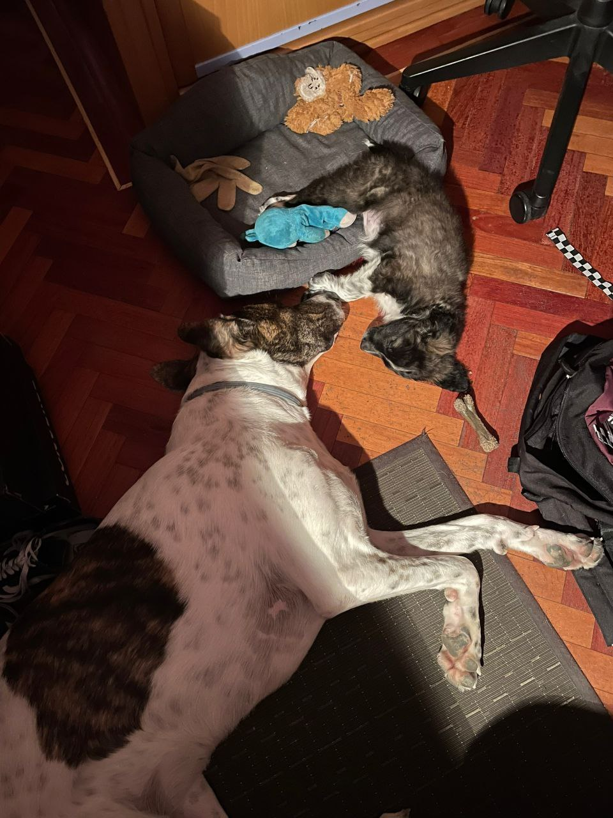
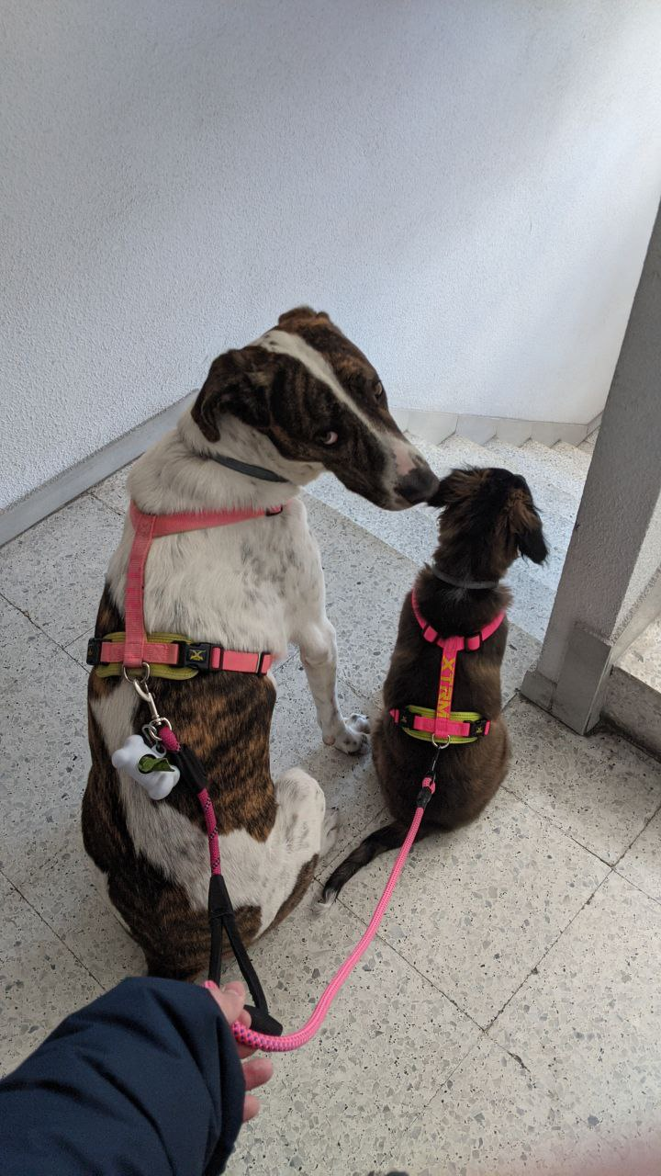

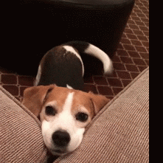
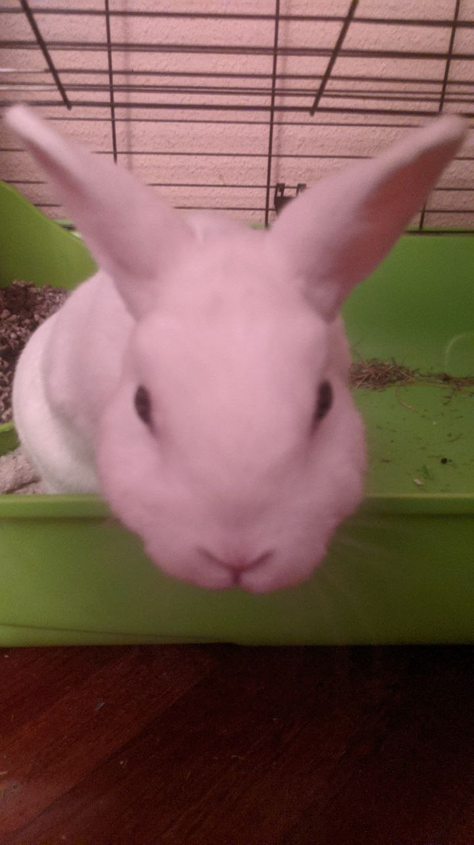
Gather Data
Notes:
So, imagine we want our car to detect whether there is a cat in front of you or a dog, in that case we should gather images from cats and dogs. So, here are some photos.

Slide 11
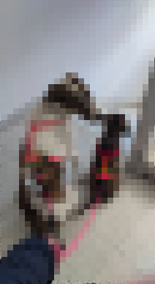
2. Process Data
0 - Perro
1 - Gato
Augmentation
Labelling
0
Notes:
Now, we process our data. This means we use augmentation to generate a wide dataset. We also use another technique called labelling, which specifies what should be the output from data. Sometimes this labelling is not only a number. In cases where you have an image and there are a bunch of objects, you have to specify where the object is by using coordinates, don’t worry, there are programs where you just have to draw the rectangle. Now. What is Augmentation? It is a technique to generate new data. In this case, transforming images into an image with an effect, for example, adding Blur, Dots, adjust light, rotate the image, and much more!! (Insert examples). Oh, we also do what is called a “split”, here we split the dataset into 2 or 3 sets depending.
Training set → For training
Validation set → For validating each training (maybe you want to know if your model is underfitting or overfitting (more of this later))
Test set → Small set which is going to be completely new for the model

Slide 12
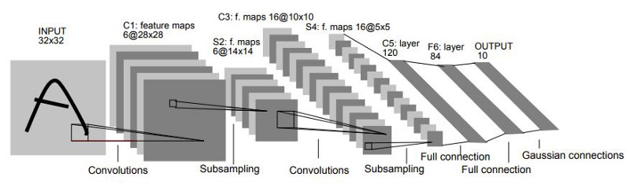
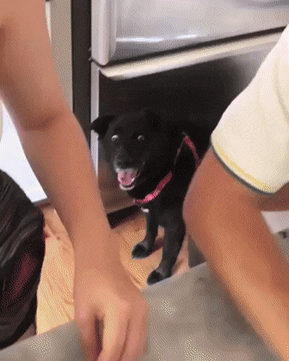

3. Design Model
Notes:
There are a lot of different models to use, we are going to try some of them like “LeNet”, “VGG16” that are pretty good at finding patterns. Oh yeah, we are gonna create our own “random” CNN : D and see how it performs vs the other ones.

Slide 13


What are Convolutions? Pooling layers? How CNN work?
3Blue1Brown → https://www.youtube.com/watch?v=KuXjwB4LzSA
Notes:
3Blue1Brown is F* awesome and I love how he does his videos. And this one talks about Convolutions. Now, convolutions are operations with 2 lists, the list returned is a larger list. The way of multiplication between lists(img). I should make the example with the dices or show it from the video. We can use these convolutions, and instead of convolving two lists of one dimensions, we multiply matrices. The matrix with what you are convolving is called Kernel, the kernel can be of any size, but be careful of dimensions!! There are lots of kernels, you can even create new images using these kernels, here are some examples. But, we are not going to use them for creating!!! Pooling Layers have the goal of resizing the image. Remember when we said that convolutions created a bigger list, when can correct that by using pooling layers. There are a bunch of them, for example the MaxPooling layer that gets the higher number from the dimensions.

Slide 14
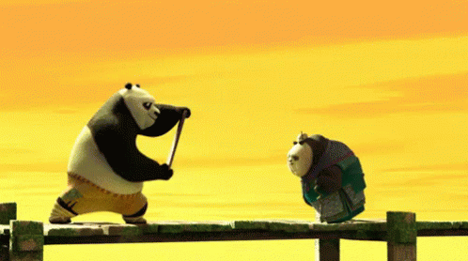
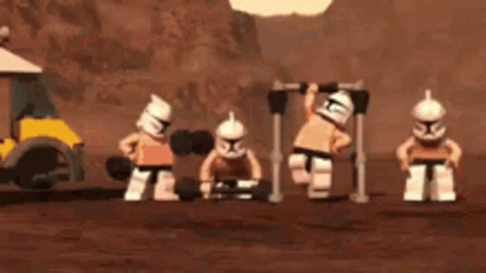
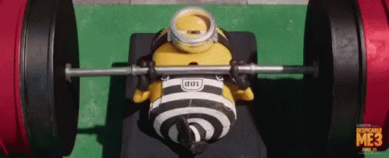
5. Train Model

Slide 15
6. Test Model
NO GIF FOUND

Slide 16
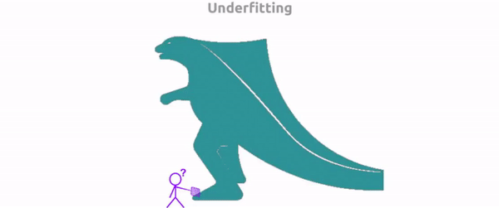
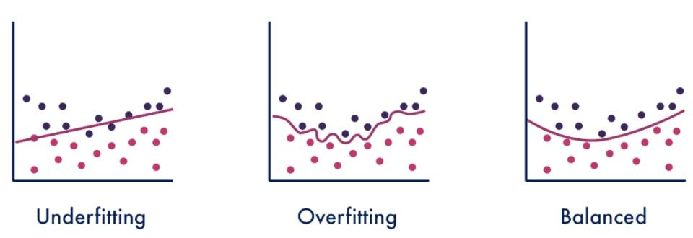
A little more!
Overfitting
Underfitting
Notes:
Overfitting is when your model is outperforming the data, that means, your model has memorized your data. Underfitting is that the model has 0 knowledge of what is going on. These can happen because of different things, for example if you don’t have a quality dataset, or you have a small dataset, your model may not be learning the features it should. On the other hand, overfitting can be caused when your learning rate is very high or very low, that means the model may get stuck into a local minima, which means it will not get out of it.

Slide 17
Hyperparameters
Learning rate
Hidden Layers
Number of neurons per layer
Number of epochs
…
Notes:
A hyperparameter is a parameter whose value is used to control the learning process

Slide 18
That is all!
Kahoot:
https://create.kahoot.it/details/cc94876c-aac6-4165-a2f9-a01e7fae7932
Practice:
https://colab.research.google.com/drive/1j6Gf3JcpFIcExWivRzmkIQb9EPdeswGy
Notes:
Roborace

Slide 19
Extra things for you
An amazing post for a deep understanding the basics of CNNs: https://ujjwalkarn.me/2016/08/11/intuitive-explanation-convnets/

